Slide 1
GPT-4o-mini Fine tuning in Azure OpenAI Studio
Elizabeth WAN, ai gbb aSIA
Aug, 2024

Slide 2
Consider fine tuning if:
You want to reduce latency. Long prompts can take longer to process, and fine tuning lets you move those long prompts into the model itself.
it’s too hard to explain in the prompt – or there are too many examples to fit in the context window, fine-tuning can save huge amount of token consumption.

Slide 3
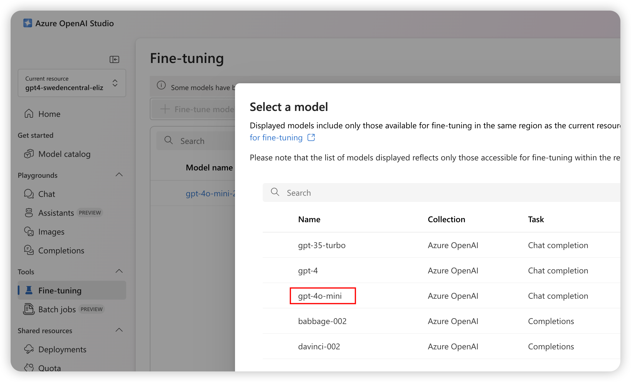
1. Low code approach of FT in Azure OpenAI Studio
Choose Foundation model
Choose correct region for model available

Slide 4
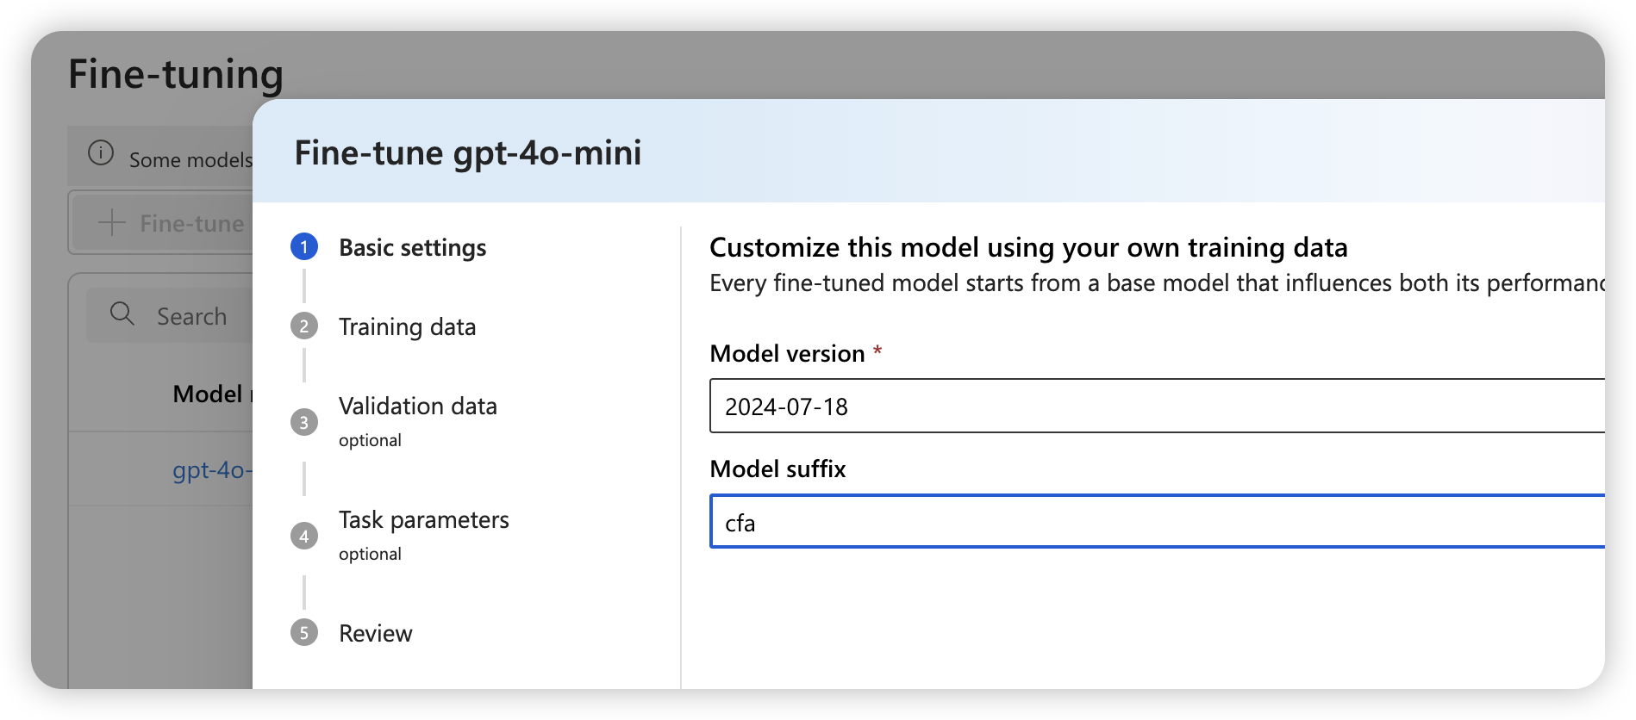
Model suffix to identify the finetuned model iterations

Slide 5
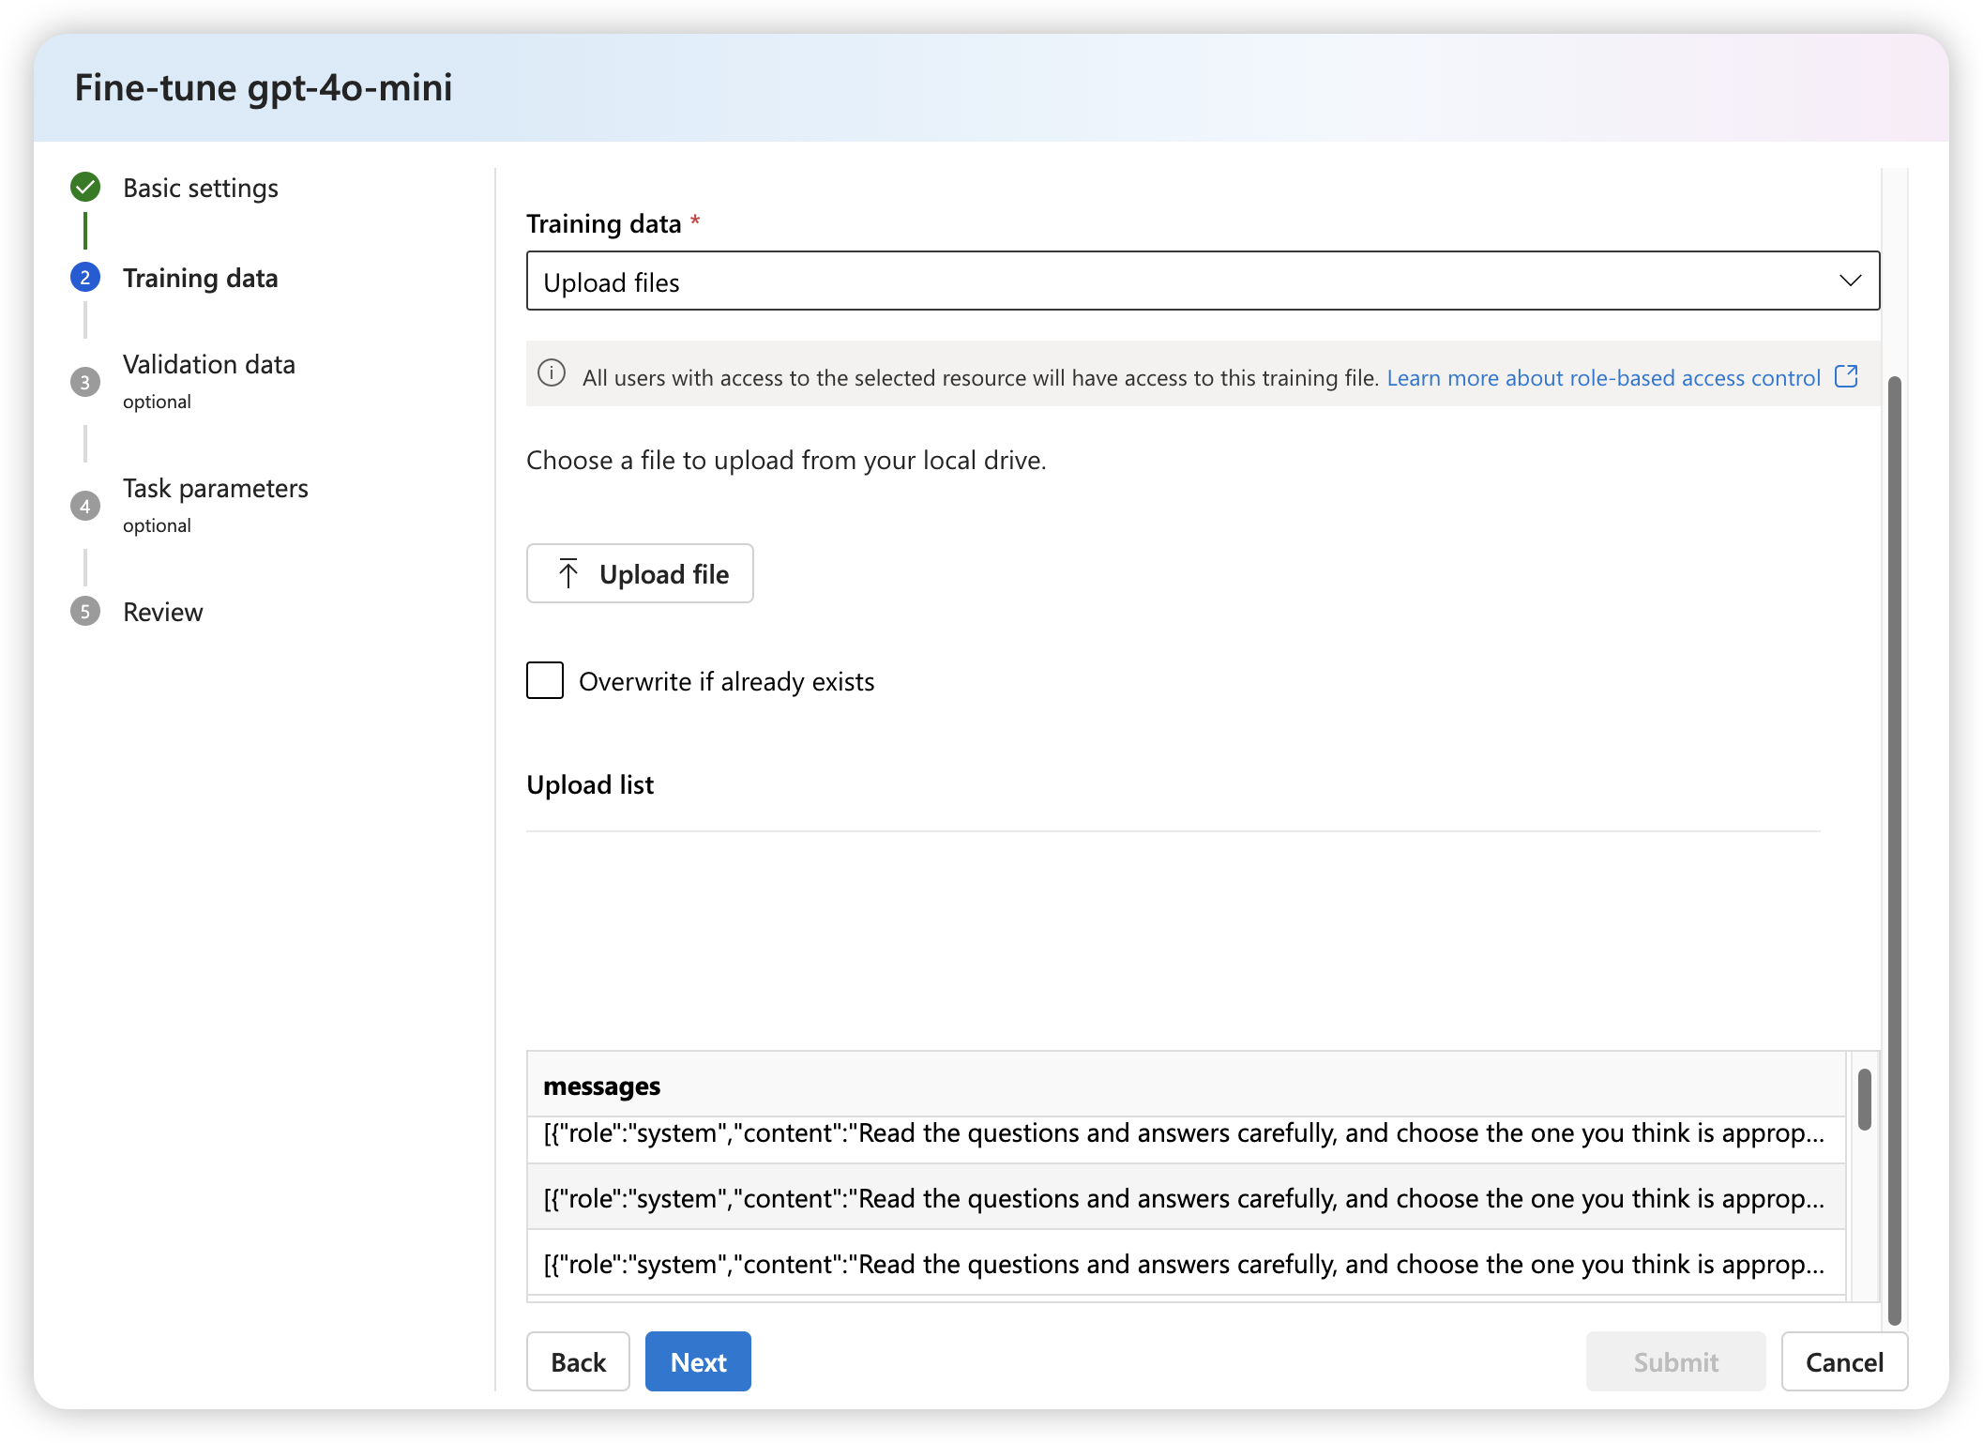
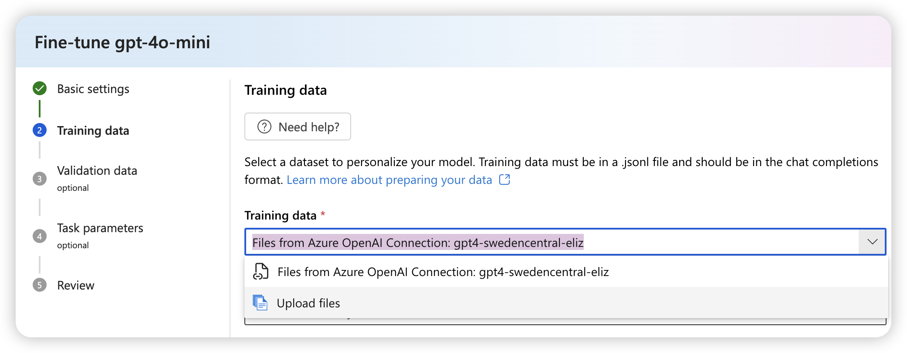
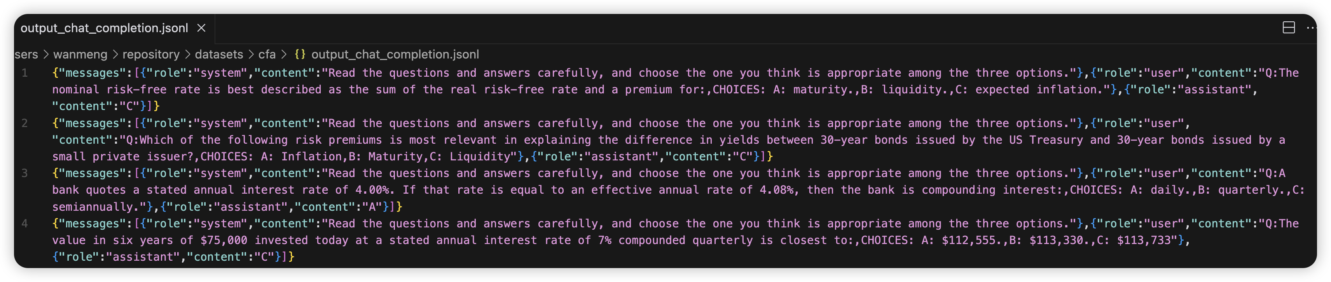
Upload a file with jsonl data format
Data format: fine-tuning dataset must be formatted in the conversational format used by Chat completion API, in JSON Lines(JSONL) format.
Example training dataset formatted to use by Chat completions API

Slide 6
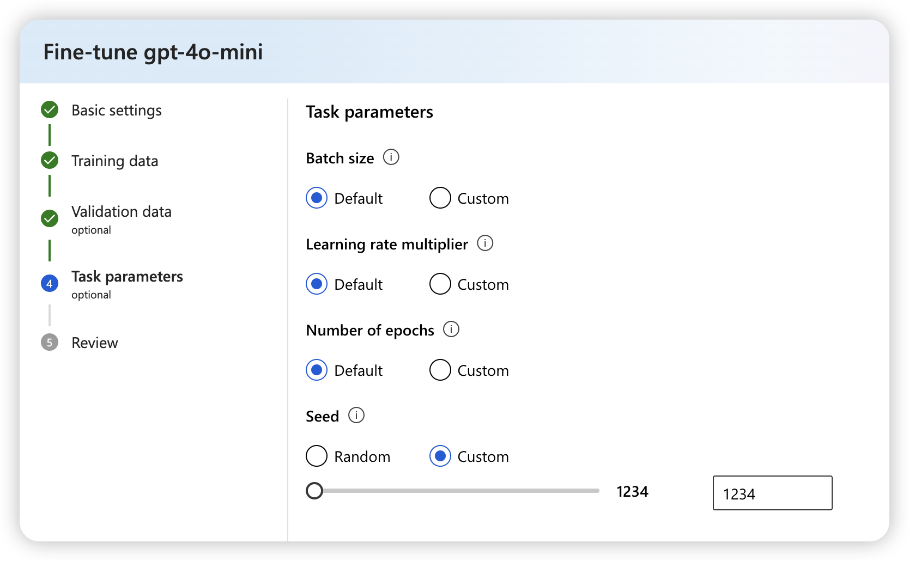
Training parameters
Default values for hyper parameter tuning
Seed Property:
for reproducible training runs –
Passing in the same seed and job parameters should produce the same results

Slide 7
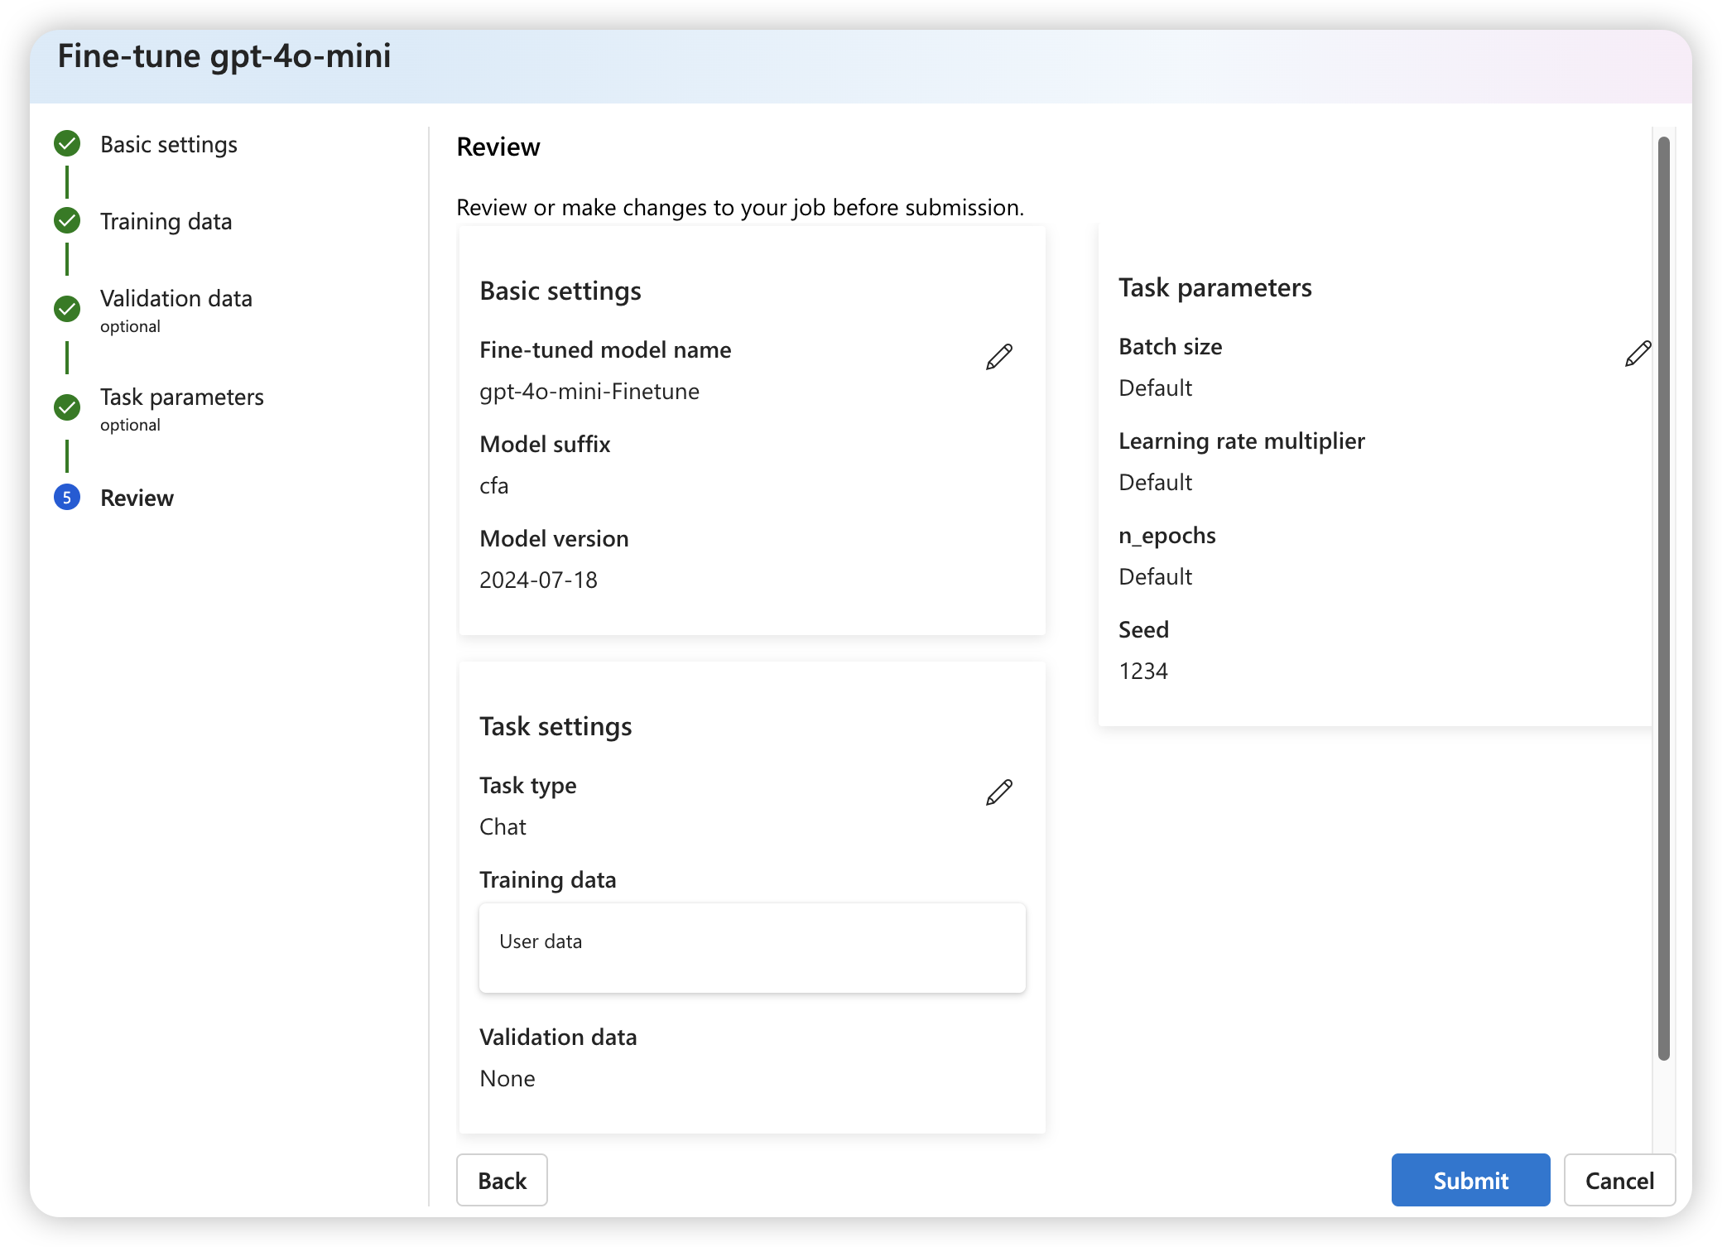
Submit the finetuning job

Slide 8
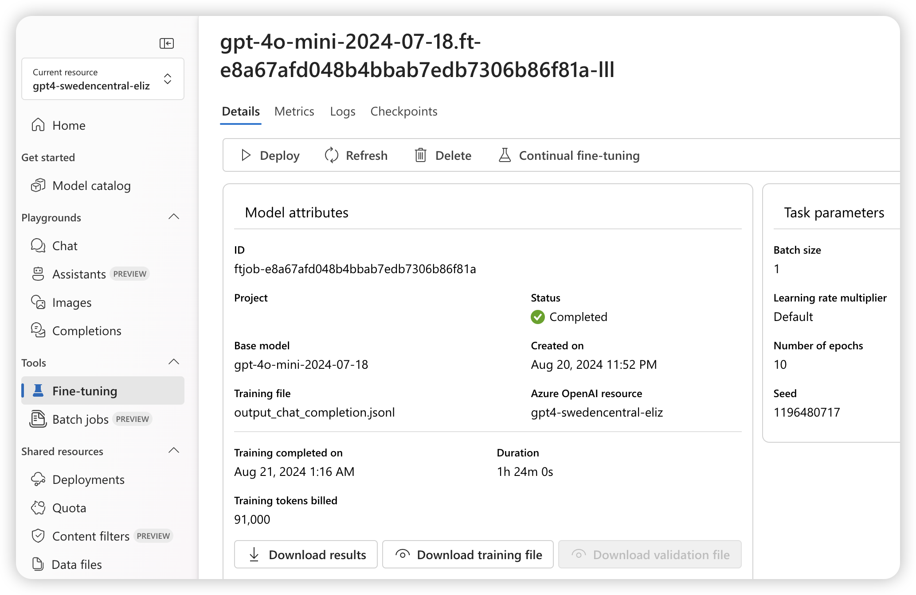
2. Finetuning job state
training tokens billed
91000*0.003/1000*10=$2.73
before: 1.5 hours = $67.5
continue fine-tuning

Slide 9
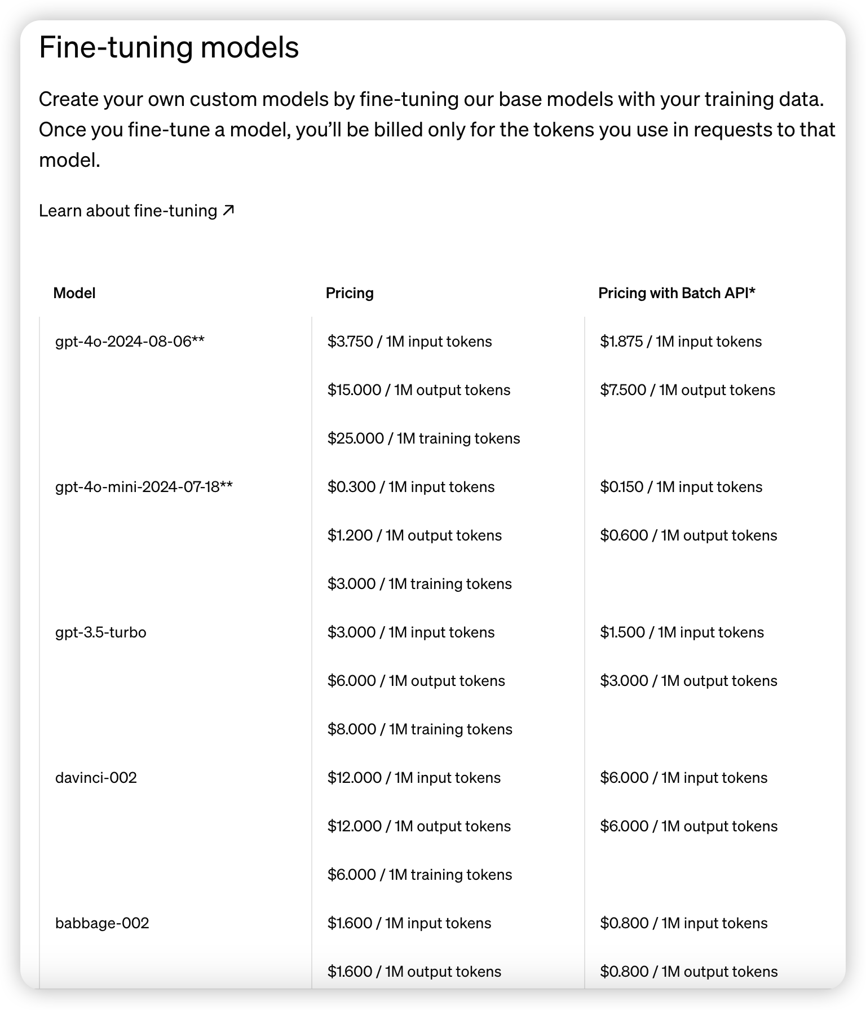
Fine-tuning pricing
*Batch API pricing requires requests to be submitted as a batch. Responses will be returned within 24 hours for a 50% discount. Learn more about Batch API ↗(opens in a new window)
‎**Fine-tuning for GPT-4o and GPT-4o mini is free up to a daily token limit through September 23, 2024. For GPT-4o, each qualifying org gets up to 1M complimentary training tokens daily and any overage will be charged at the normal rate of $25.00/1M tokens. For GPT-4o mini, each qualifying org gets up to 2M complimentary training tokens daily and any overage will be charged at the normal rate of $3.00/1M tokens.
Inside Azure AI Series - GPT4o Fine Tuning.pptx (sharepoint.com)

Slide 10
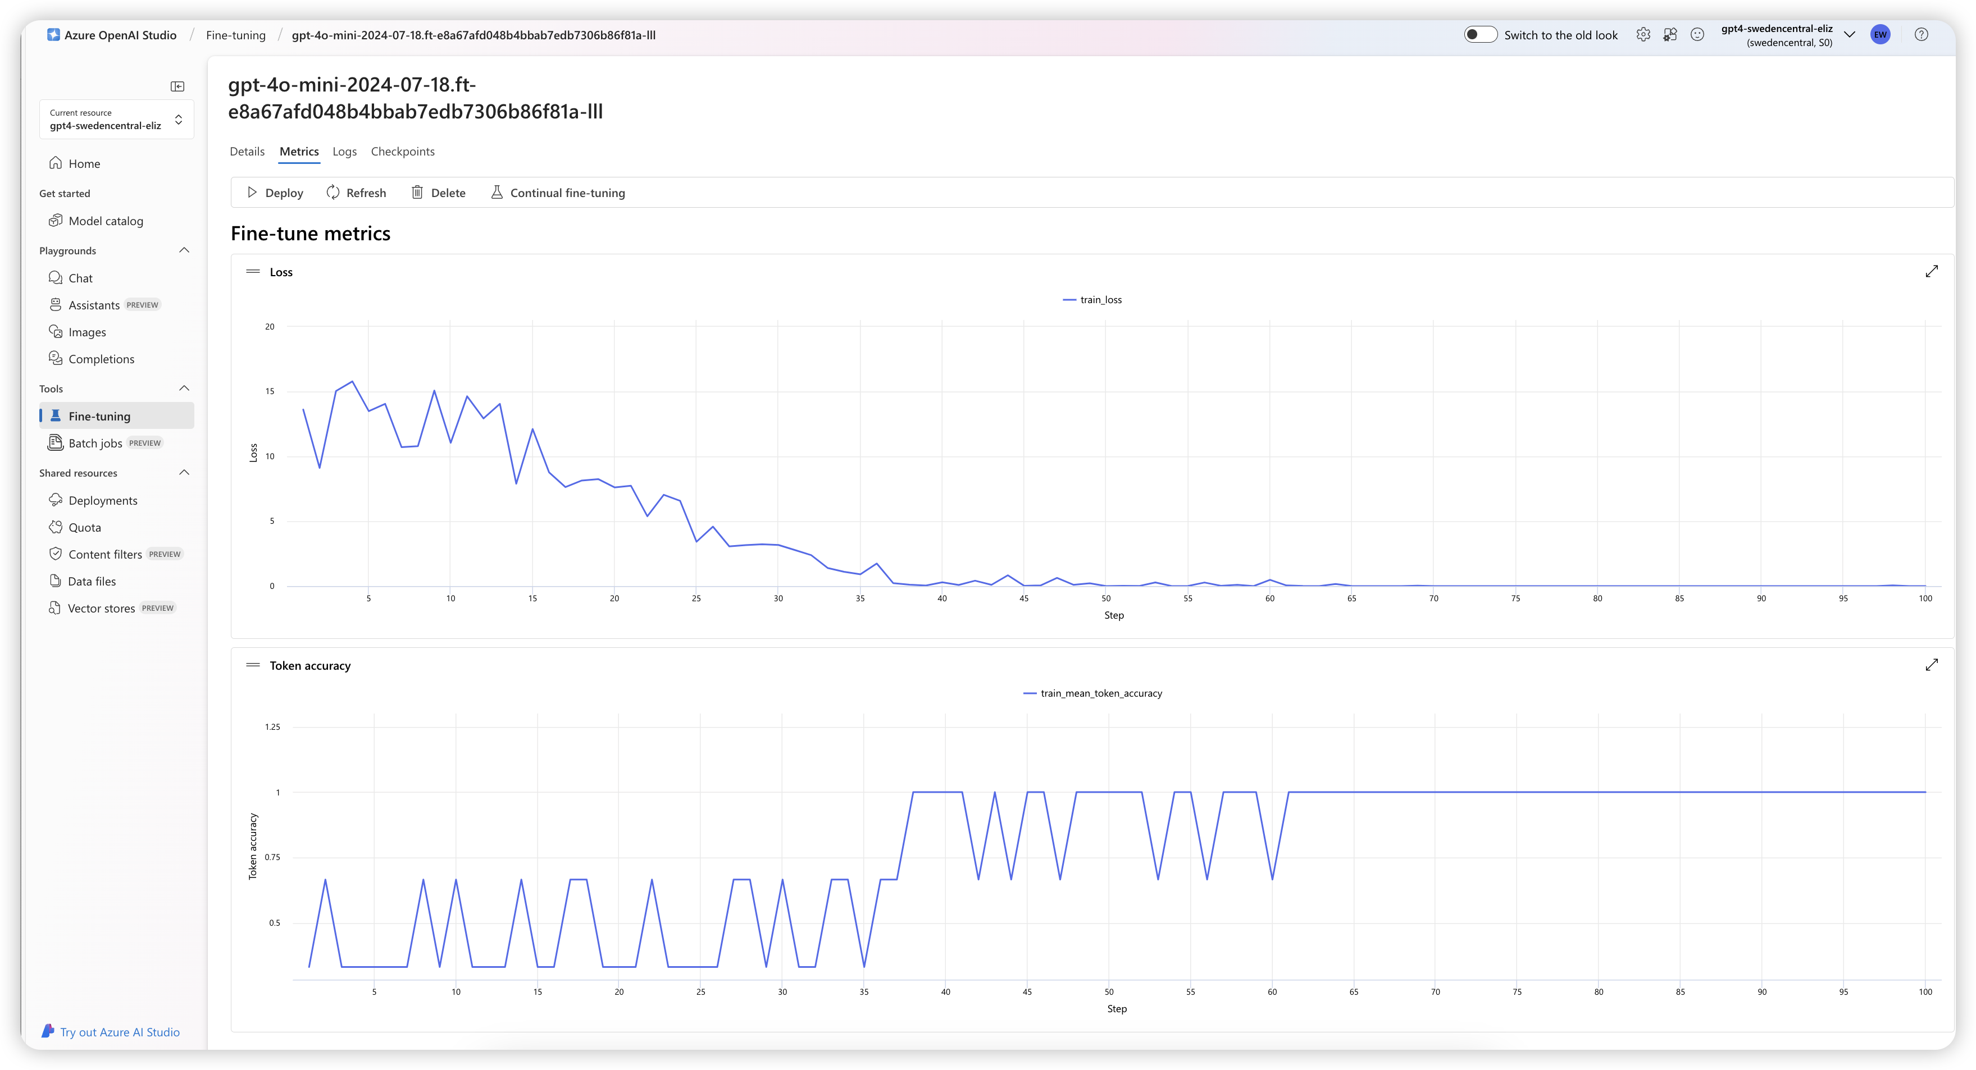
Full validation statistics:
Detailed information on accuracy and loss

Slide 11
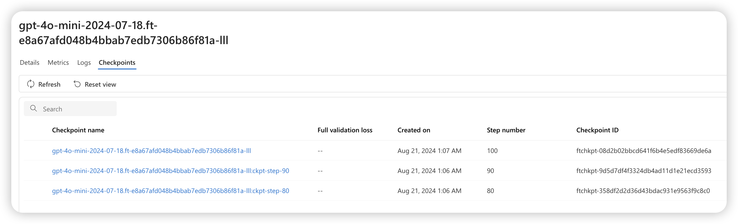
Checkpoint support in API, AI Studio
每个epoch结束会产生一个checkpoint,可部署，也可以继续微调。
checkpoint优势：是模型过拟合发生之前的快照。当一个ft job结束，会有三个最近版本的模型可供deploy.
训练过程中发生的过拟合，常常需要选择在验证集上性能最好的模型.
最后一个epoch是用来代表FT模型，其他两个作为checkpoints

Slide 12
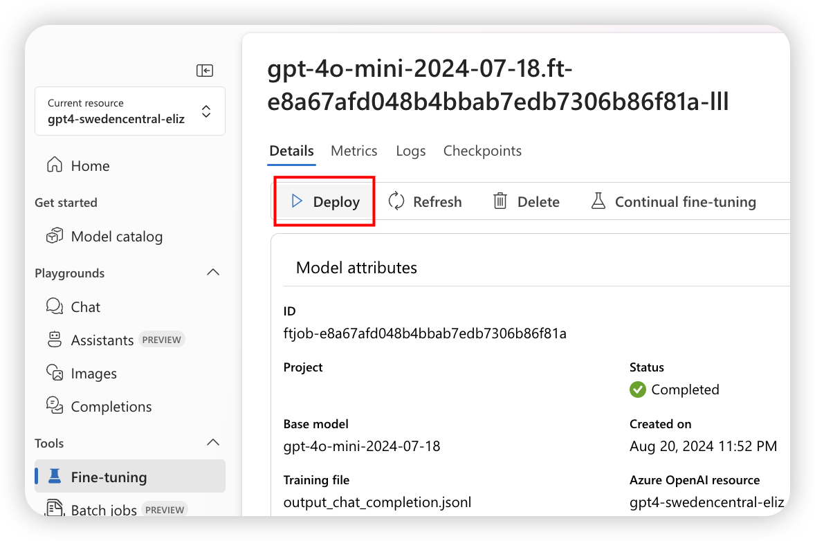
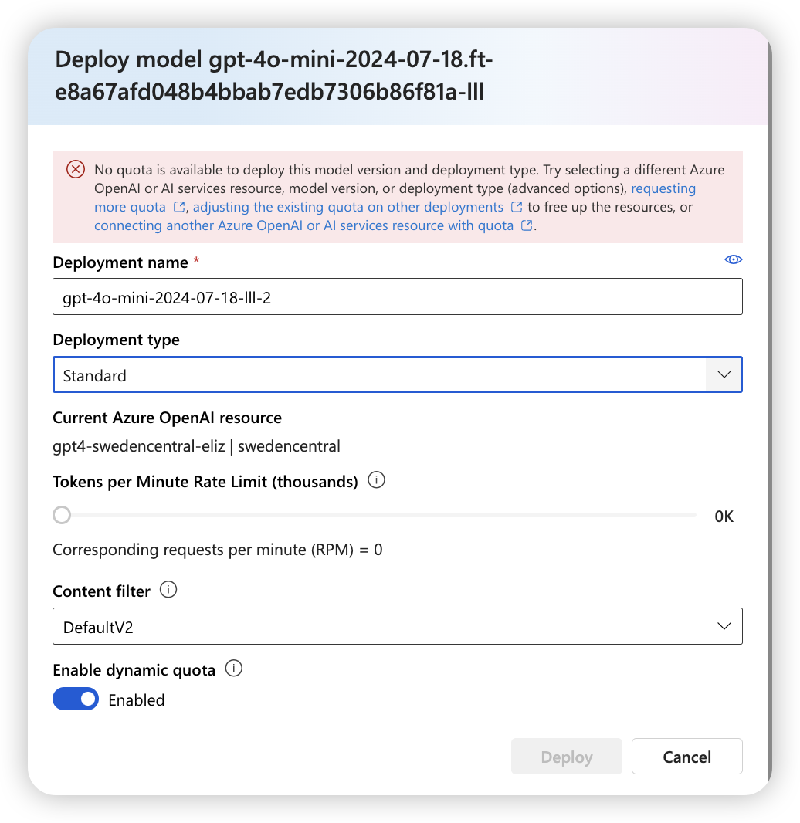
3. Deployment finetuned model

Slide 13
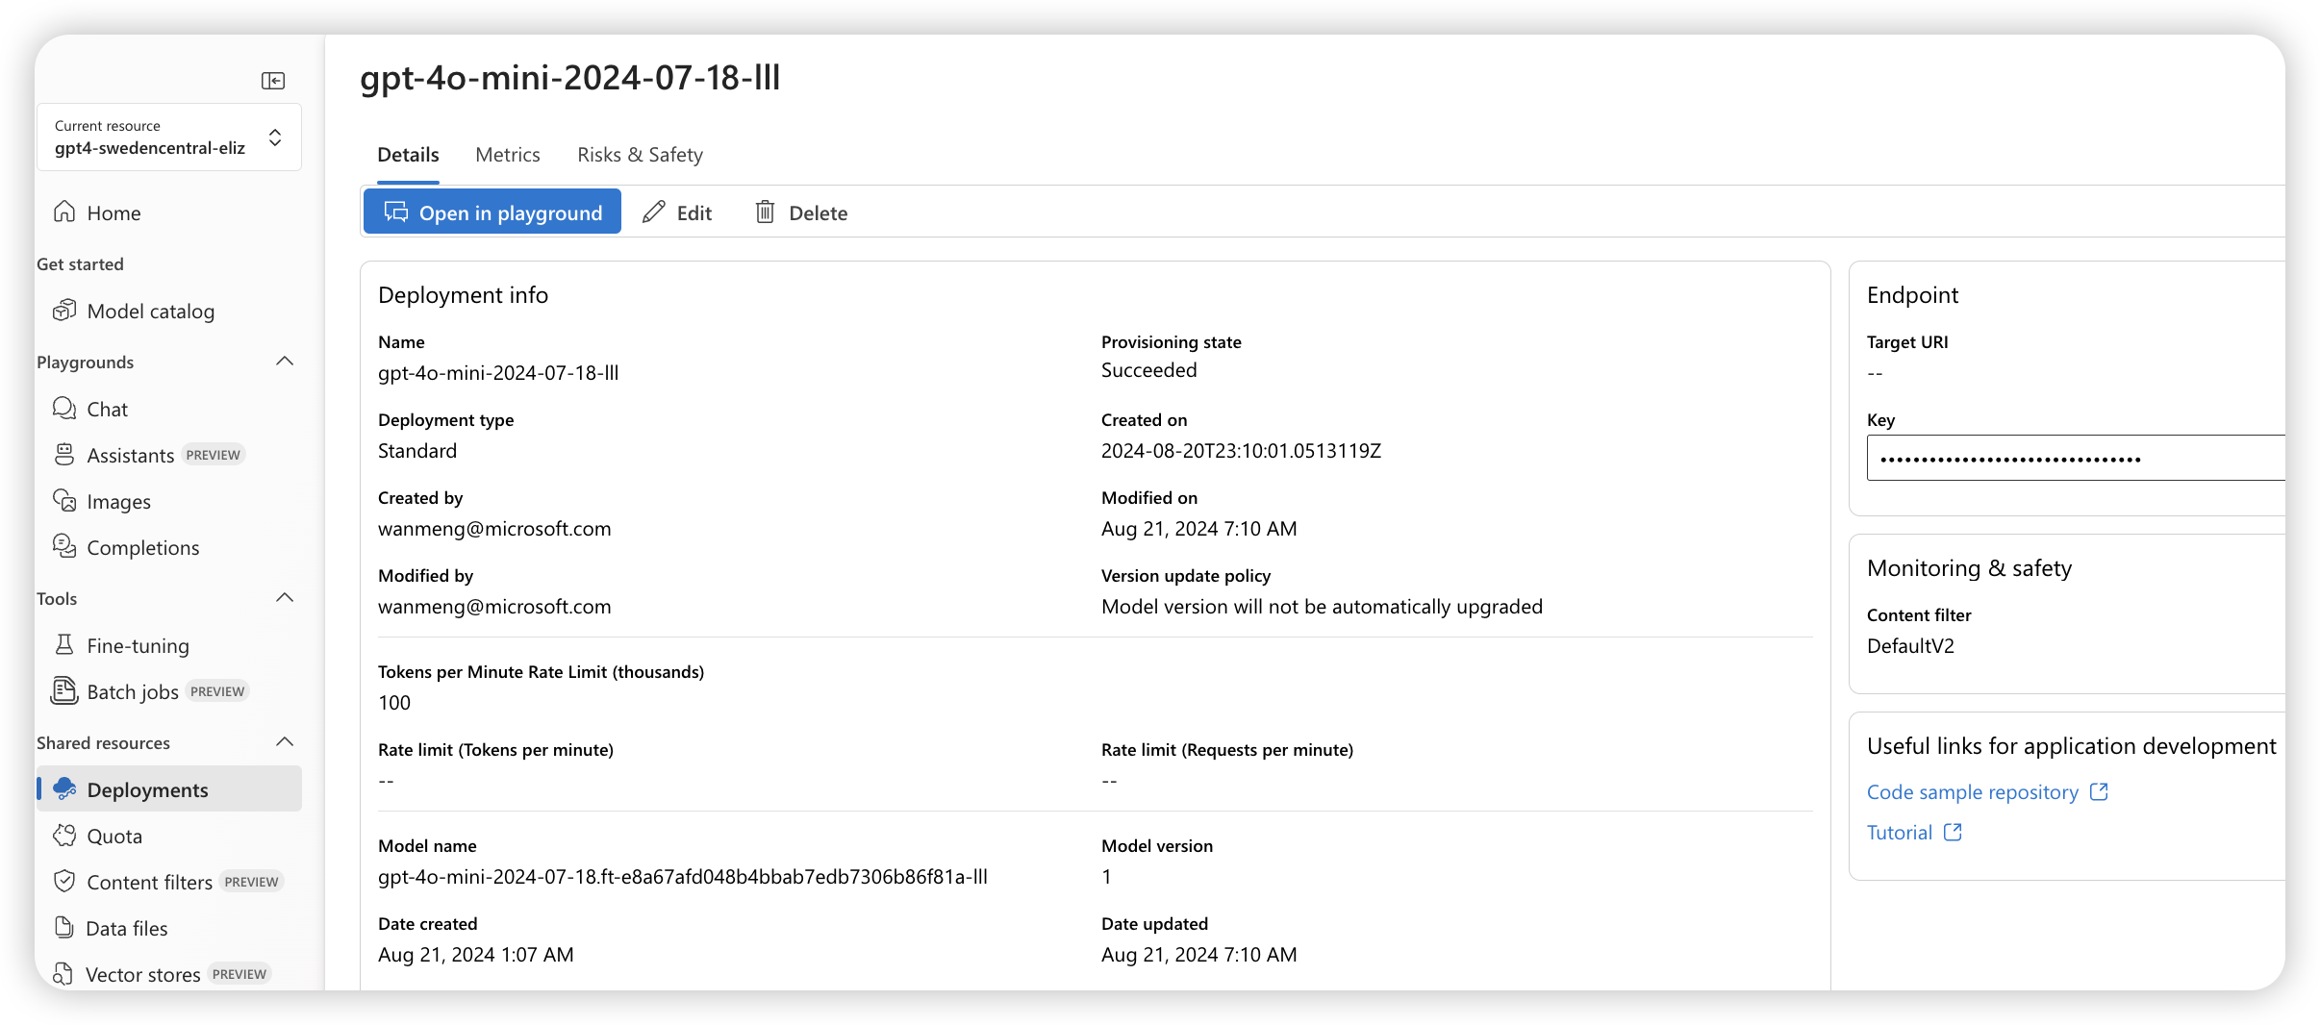
Deploy to playground or API
it takes ~ 10 min to succeed

Slide 14
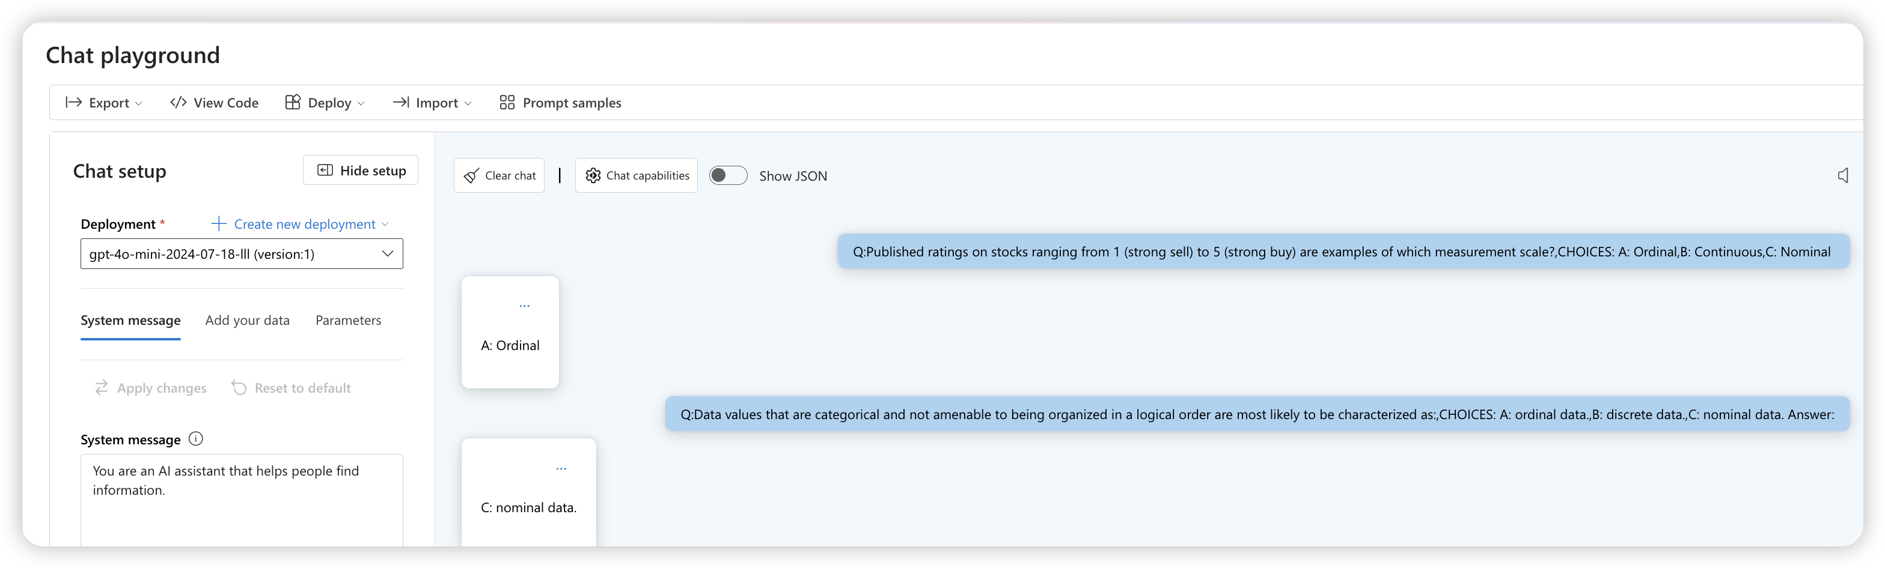
Chat playground testing for new test data

Slide 15
4. Clean up deployments, finetuned models and training files
Delete ft model deployment: each customized (fine-tuned) model that‘s deployed incurs an hourly hosting cost - $5 per hour regardless of whether completions or chat completions calls are being made to the model.
Delete the ft model: You must first delete your model deployment before you can delete your fine-tuned model.
Delete training files in Management > Data files pane.

Slide 16
FAQ: My ft model does not seem to improve
No enough data: while 10 is the minimum for the pipeline to run, you need hundreds to thousands of data points to teach the model a new skill. Too few data points risks overfitting and poor generalization. Your fine-tuned model may perform well on the training data, but poorly on other data because it has memorized the training examples instead of learning patterns. For best results, plan to prepare a data set with hundreds or thousands of data points.
Bad data: A poorly curated or unrepresentative dataset will produce a low-quality model. Your model may learn inaccurate or biased patterns from your dataset. For example, if you are training a chatbot for customer service, but only provide training data for one scenario (e.g. item returns) it will not know how to respond to other scenarios. Or, if your training data is bad (contains incorrect responses), your model will learn to provide incorrect results.

